Slide 1
The Common Simulation Framework 10/25/2014
Jorge Calderón
Master of Liberal Arts (ALM) Candidate
Information Technology, Concentration in Software Engineering
Extension School, Division of Continuing Education
Harvard University

Slide 2
Agent-based Modeling (ABM)
Complex natural phenomena are modeled as collections of interacting autonomous agents.
Emphasis on studying the emergence of complex system-wide behavior arising even from relatively simple behavioral rules at the individual agent level.
May provide insight into system-wide behavior in cases where formal mathematical models are insufficient or computationally intractable, particularly in complex adaptive systems.
Agent-based models are applied in simulation (ABMS) to run virtual experiments using Monte Carlo methods.

Slide 3
ABMS: Virtual Experimentation
Agent-based modeling simulation has been described as “third leg of scientific investigation” used in conjunction with traditional inductive and deductive methods of reasoning ().
Revolutionary and controversial approach, finding use across the natural, behavioral, and social sciences.
Everything from evolutionary linguistics to game theory to oceanography.
Example: The Federal Reserve is now experimenting with these methods as traditional macroeconomic forecasting methods have failed to warn of financial catastrophes
Main Premise: Complex systems often cannot be modeled under system-wide equilibrium conditions. The real world is composed of agents that perceive and behave based on their local environments. Interactions among agents may result in occasional system-wide instability, which traditional models often fail to predict.

Slide 4
Multi-agent Systems
Collections of interacting autonomous intelligent software agents working towards a goal.
Engineering/Computer-science/artifical-intelligence focused
Often implemented as distributed systems, either as simulations (MASS) or not.
Examples: Trading systems such as Trading Agent Competition (TAC) for research in wholesale energy markets trading, robotics (interacting robots)

Slide 5
Multi-agent Based Simulation: MAS used in ABMSs
Implementation of Multi-agent Systems (including Artificial Intelligence) in Agent-based modeling and Simulation
Application of sophisticated agent-level models in ABMSs, including models such as the Beliefs-Desires-Intensions (BDI) model of practical human reasoning.
The MAS/Artificial intelligence community may provide the scientific community with more sophisticated agent-level modeling tools than currently in common usage.
Largely untapped method; the ABM community has not yet fully taken advantage of what MAS has to offer it.

Slide 6
Slow adoption of MABS: Why?
Hypothesis:
The ABM community, by and large, is not computer-science oriented.
Strong preference for:
simpler simulation and agent-level modeling tools
simpler programming languages
single systems or at least “pre-integrated” groups of interacting systems.
For MABS to be successful, the MAS/artificial intelligence community must adapt to ABMS, not the other way around.

Slide 7
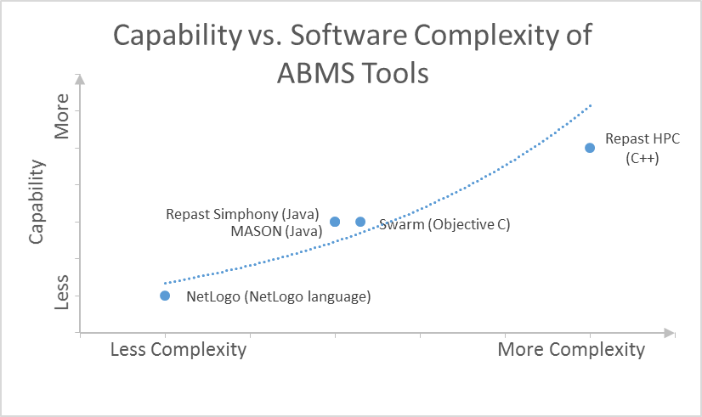
ABM Simulation Software Capability vs. Complexity

Slide 8
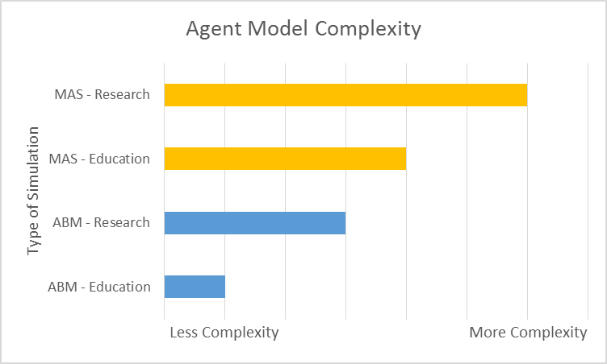
Agent Model Complexity: MAS vs. ABM and Education vs. Research

Slide 9
Benefits of Integrated MAS-ABMS
Global view of the environment exposed to the researcher
Local view of the enivironment exposed to the individual agents.
Native ABM Simulation Toolkits: ABM rersearchers continue to use toolkits they are already familiar with (re-use existing simulations).
Native MAS Systems: MAS Agent Authors have the fully power of MAS, standards-compliant agent-to-agent messaging, and agent-modeling artificial intelligence at their disposal.

Slide 10
Benefits of Integrated MAS-ABMS (cont.)
Simple system models can be created and populated with sophisticated intelligent agents and multi-agent systems.
Intelligent agents can be created either by artificial intelligence experts, or by ABM researchers without having to special code agent-to-agent messaging or integration into a macro-level ABM simulation environment.

Slide 11
Benefits of Integrated MAS-ABMS (cont. 2)
Agent Code Hiding
Useful in competitive simulations: Game Theory Tournaments
Special cases: Consider the scenario where an economist wishes to study the effect of automated trading on the stability of financial markets. What better way than to use real-world trading algorithms? These are proprietary. Both the source and compiled agent code must remain hidden.
Use of MAS to support large-scale distributed ABM simulations
Implementation of a heterogeneous computing environment (bypass the need for a computing cluster)

Slide 12
MAS in ABMS: A Special Case of a Broader Problem: Interoperability of Agent-based Systems
Allow interoperability not just between MAS and ABMS, but across ABMS systems.
Each domain expert/researcher can model agents in his/her agent-modeling system of choice.
Interoperability across programming languages (ranging from simple such as NetLogo to complex such as C++)
Support interdisciplinary simulations: Let ecologists model environments, econonists model people and organizations, epidemiologists model pathogens, etc.
“Fill-in” missing ABMS toolkit functionality
E.g. Multi-threading simulations, database storage, etc.

Slide 13
The Common Simulation Framework
Uses a single “master” ABMS for any given simulation execution.
Support multiple simultaneous distributed systems of agents, either MASs or independent agents in any given simulation run.
Global identification of simulations, simulation versions, and simulation runs.
Simplifies the integration of Monte Carlo simulation data distributed temporally and across organizations when collaboration was not initially planned for.
Current scope:
Repast Simphony (Java) for the ABMS
JADE (Java) for a MAS including JaCaMo agents
Generic individual Java agents, including JASON-modeled agents
(Current scope) Framework support for
Distributed ABM simulations
Competitive Game Theory Tournaments
Programmatic execution of Repast-Simphony-only simulations

Slide 14
The Programming Game Framework
Superset of the Common Simulation Framework
Supports Game Theory Tournaments including,
Prisoner’s Dilemma Tournament
Rubenstein Bargaining (uses direct agent-to-agent FIPA messaging)
Can be used in computational economics and game theory courses, and the agent-based computational economics (ACE) community.

Slide 15
Future Work
Mapping single JADE agents to multiple simulation-toolkit agents to support large ABM simulations (prevent overuse of threads)
Wrappers to channel Java RMI communication via bidirectional HTTP and HTML5 web sockets to overcome NAT and firewall restrictions
Support for web services between MAS and ABMS (current: in-memory Redis cache)
Support multiple ABMS tools, such as NetLogo and Repast HPC
Support multiple agent modeling tools such as NetLogo.
Creation of a Simulation and Agent Repository for the sharing of agents and simulation
Re-use of agent models
Building new larger and more sophisticated models from existing models created across scientific disciplines.

Slide 16
Other Potential Uses for the Common Simulation Framework
Trading Agent Competition
Replace the custom-software solution currently used with existing tools (Repast/JADE) tied together with the Common Simulation Framework.
Use of existing commonly-used tools may encourage participation.
Cross-University Game Theory Competitions
Role-Playing (real-time) Simulations
GUI wrappers added to game theory competition agents
MBA students in real-time vs. game theory software agents already created by computer science undergrads
Adapted for research in experimental economics (provide economists with data)
Suggested by others
Teaching Machine Learning (L. Tesfatsion, Iowa State)
Testing of Robotic Algorithms (E. Silva)

Slide 17
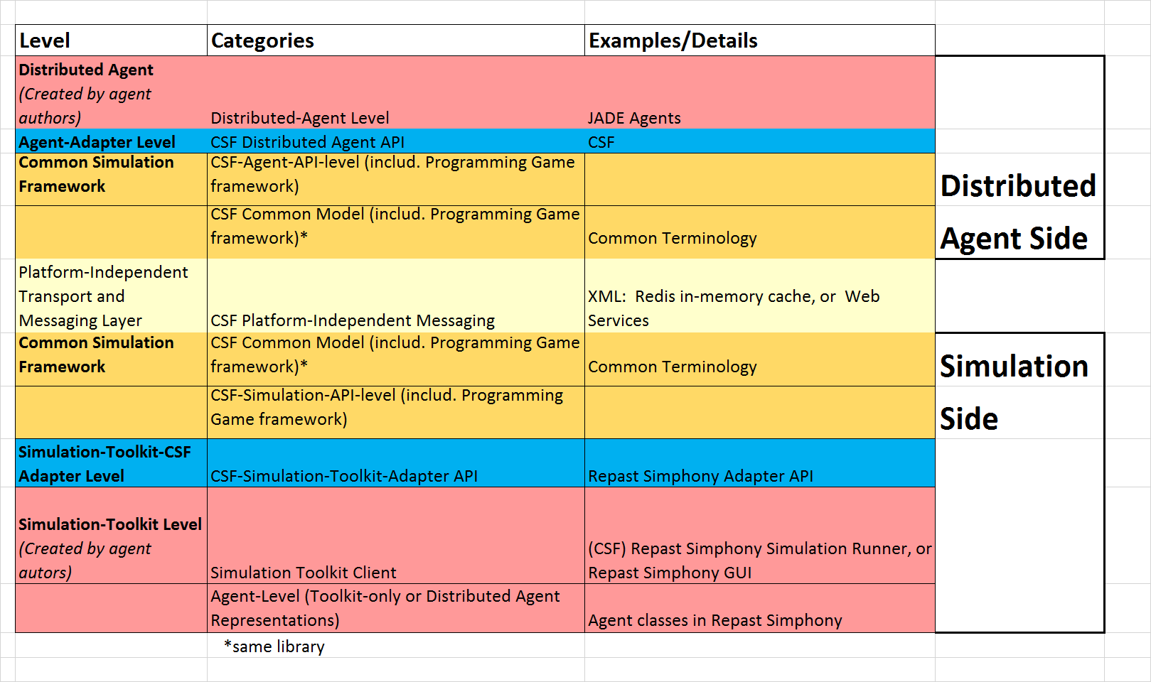
The Software Model

Slide 18
Questions?

